Slide 1

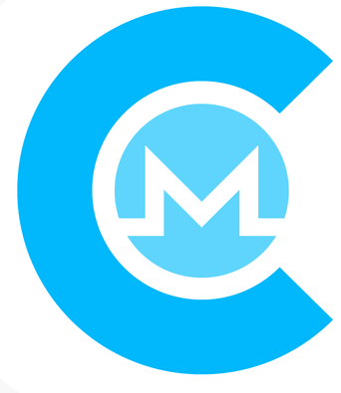

Cake Wallet
cakewallet.io
Welcome You!
and
monerotalk.live

Slide 2



Who Am I?
Justin Ehrenhofer
Organizer of the Monero Community Workgroup and the Monero Malware Response Workgroup
Board Member of MAGIC (https://magicgrants.org)
Senior moderator of r/CryptoCurrency
Host of Breaking Monero
Publisher of Mastering Monero

Slide 3
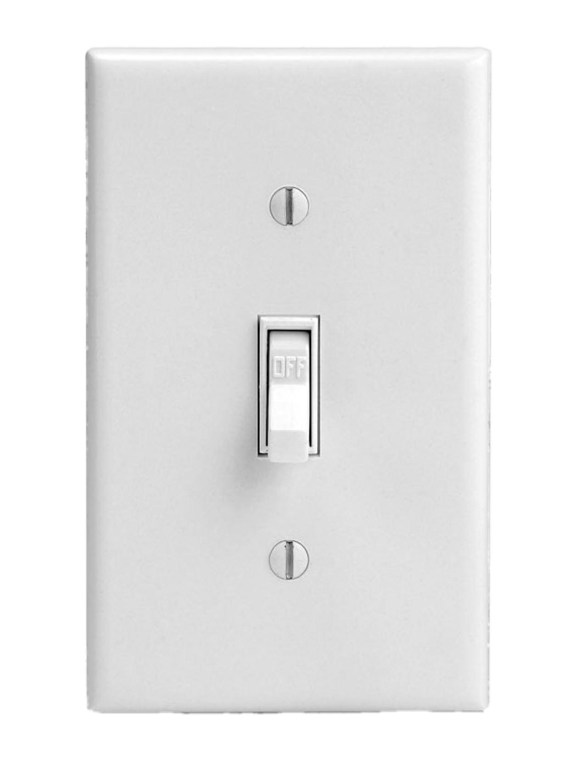
Privacy Isn’t Binary
What most people think privacy is:

Slide 4
Privacy Isn’t Binary
What privacy actually is:
Perfect Privacy
Perfect Transparency

Slide 5
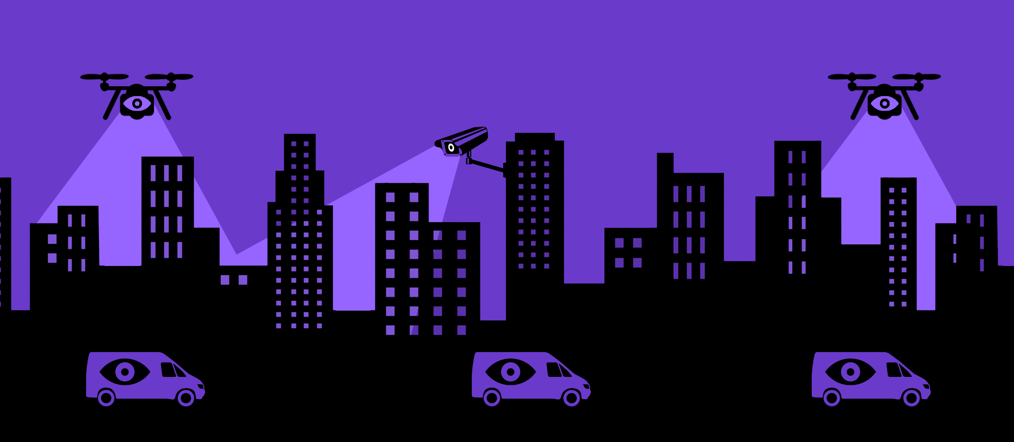
It All Comes Back to a Threat Model
Image courtesy of EFF

Slide 6
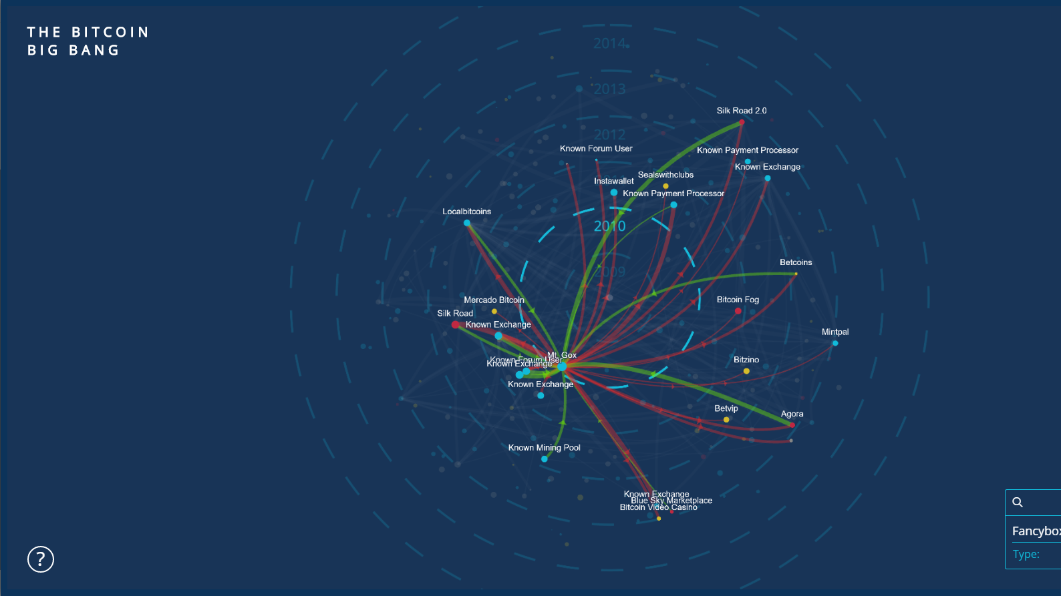

Bitcoin is NOT (very) private!
Notes:
Bitcoin is not private! In fact, it is perhaps the most transparent money system ever made. Everyone in the world can see a history of the following:
The amount of money in a wallet
Where the Bitcoin came from
Where the Bitcoin went
This visualization shows the transfer of Bitcoin from large accounts to others. It is a visual representation of transfers of Bitcoin.

Slide 7

Transparency Has Implications on People and Business
Sources
Expenses
$
Balances
Employer info
Family and friend connections
Business suppliers and upstream business connections
Fungibility
Political and religious affiliations
Health data and doctors
Customers and downstream business connections
Everyday purchasing habits
Employees
How much money you have
Targeted crime against wealthy individuals and companies, especially in cases of malware and robbery
Willingness to pay suppliers and charge customers
Willingness to pay employees

Slide 8
Tools Can Be Added to Transparent Systems. Their Effectiveness is Complicated
Probably not; it’s complicated
MIXER
TUMBLER
zkSNARK
zkSTARK
Highly transparent
Could be effective

Slide 9
Transparency Is Important… For the Right People
Sender:
****************
Receiver:
****************
Amount:
****************

Slide 10
Transparency Is Important… For the Right People
Sender:
Bob
Receiver:
Alice
Amount:
5

Slide 11
Transparency Is Important… For the Right People
View Key
Sender:
Bob
Receiver:
****************
Amount:
****************
Sender:
****************
Receiver:
****************
Amount:
****************
Notes:
Amount is situationally hidden. It is visible if both of the following are true:
The ring signature only includes one possible spent output (no own decoys in ring)
There are only two outputs, at least one of which is a change output

Slide 12

Transparency Is Important… For the Right People
View Key + key image
Sender:
Bob
Receiver:
Alice
Amount:
5
Sender:
****************
Receiver:
****************
Amount:
****************
Notes:
Amount is situationally hidden. It is visible if both of the following are true:
The ring signature only includes one possible spent output (no own decoys in ring)
There are only two outputs, at least one of which is a change output

Slide 13
Zero-Knowledge Does Not Mean Perfect
Monero
Ring signatures are not perfect
Zcash
Turnstile migration process is difficult, likely impossible
Sapling introduces more output metadata
Both
Some output metadata
Timing attacks

Slide 14


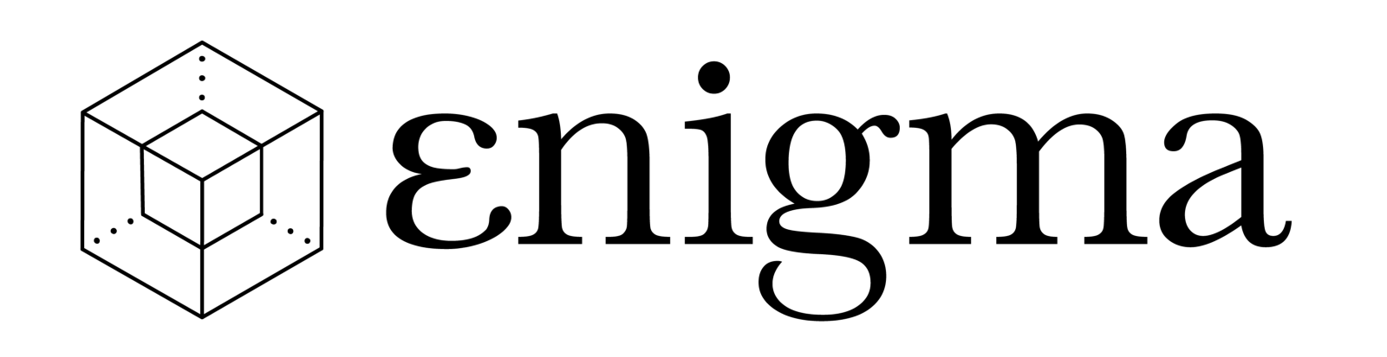

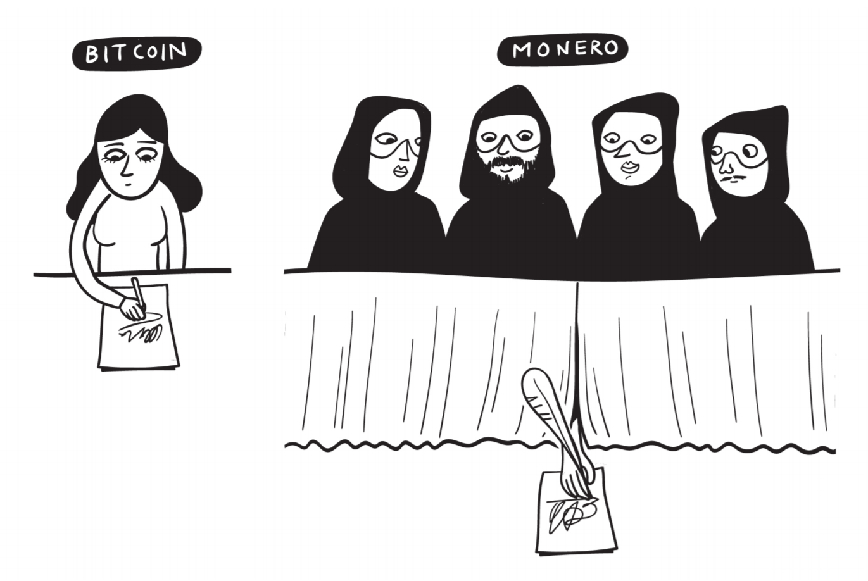
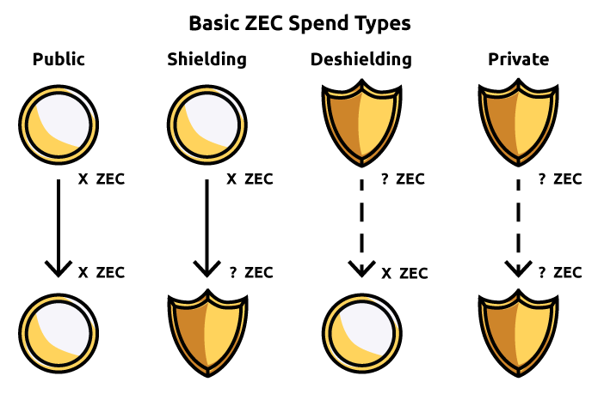
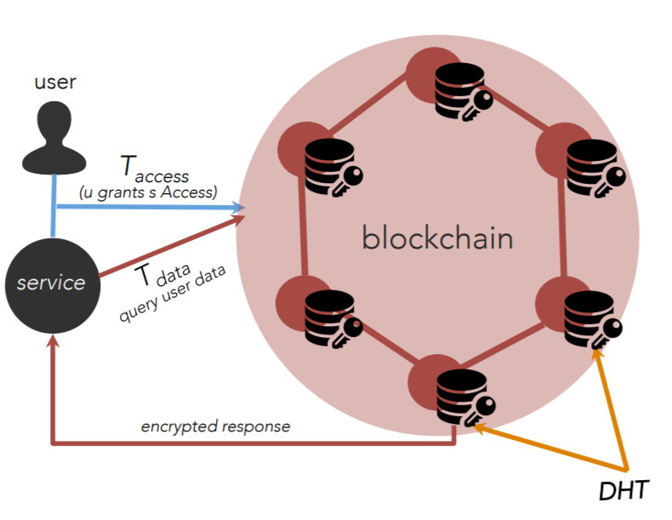
Privacy Solutions to Consider
Coming SoonTM
Ring signatures
RingCT
Stealth addressess
File encryption on central server
Hash stored on blockchain
zkSNARKs
zkSTARKs

Slide 15



Privacy Matrix
Accessibility & Usability
Theoretical Maximum Privacy

Slide 16
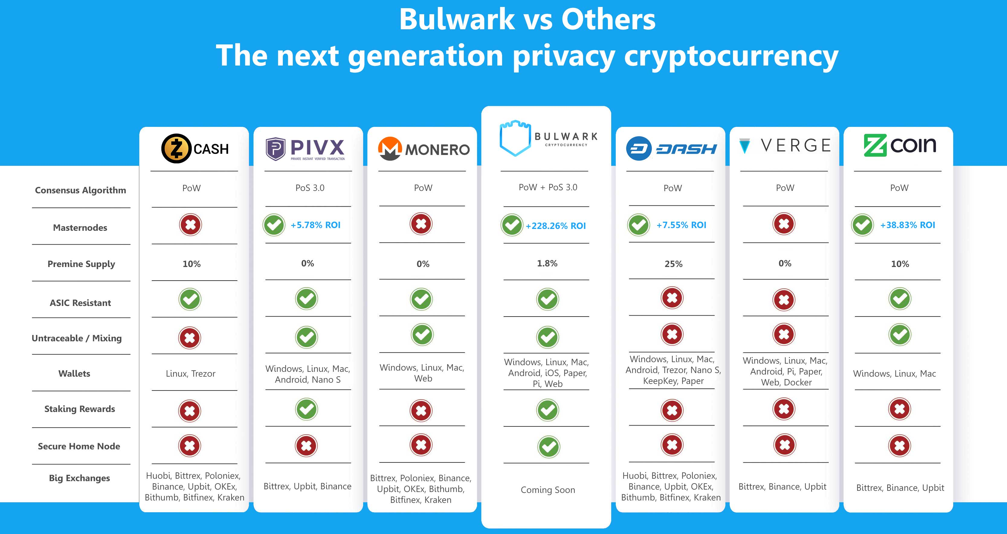
A Quick Note About Comparison Charts

Slide 17
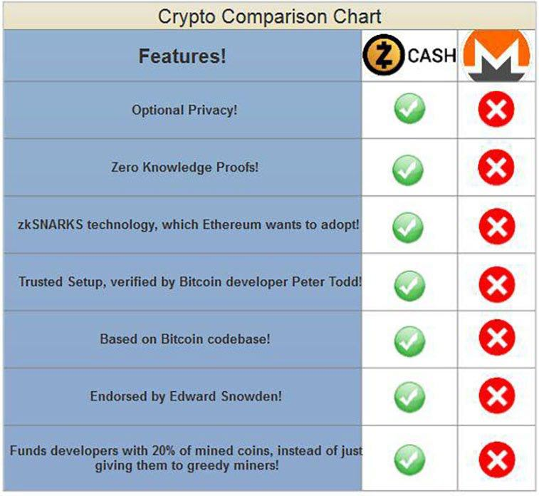
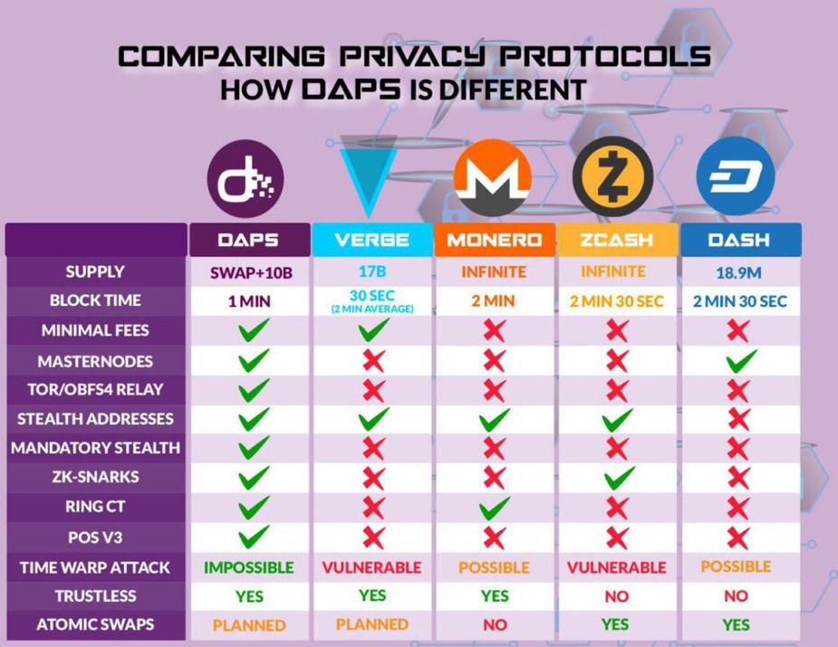
A Quick Note About Comparison Charts

Slide 18


Privacy Solutions to Consider
Source of Funds
Receiver
Amount
Transaction Size
Verification Time
Signing Time
Decent Protection
Protected
Protected
~1.9kB
Milliseconds
Milliseconds
Not Protected
Not Protected
Not Protected
~0.3kB
Milliseconds
Milliseconds
Protected
Protected
Protected
~1kB
Milliseconds
~2.3 seconds
Protected if Shielded
Not Protected*
Mostly Not Protected
~20kB*
Not Sure
~10 seconds

Slide 19
The Monero Difference
SENDER
AMOUNT
TRANSACTION
BROADCAST
RECEIVER
ɱ
RING
SIGNATURES
RING CONFIDENTIAL
TRANSACTIONS (RINGCT)
I2P, TOR,
DANDELION
STEALTH
ADDRESSES
Notes:
Monero is different from a mixing service. It uses three technologies and a work-in-progress fourth technology to provide trustless privacy for all transactions. These technologies work together to protect different parts of a transaction. The sender is hidden with ring signatures. The amount is hidden with ring confidential transactions, or RingCT. The transaction broadcast is not currently hidden without extra steps, but Monero is working on Kovri, an I2P router, to hide this with no additional effort. The receiver is hidden with stealth addresses. All of these technologies will be addressed in this presentation.

Slide 20

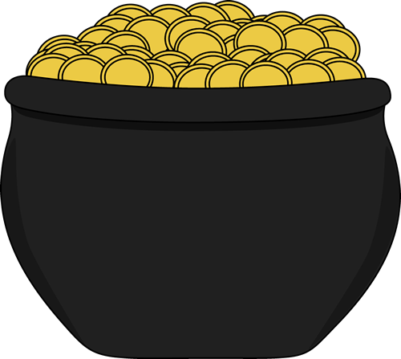
Ring Signatures & RingCT
8 (Tx ID hng6iwfumwf8)
8 (Tx ID hng6iwfumwf8)
15 (Tx ID wn3f4diiijffwn)
1 (Tx ID e4hn4ifqyd5ed)
15 (Tx ID wn3f4diiijffwn)
2 (Tx ID eshgni5lsvnf74)
9 (Tx ID cb8vqfi8dfj65f)
16 (Tx ID 5 f8wnfdmmii)
3 (Tx ID wb4f5hdfdicnd)
10 (Tx ID fnidmfnu3dm8)
17 (Tx ID h8fn5mdfi4w)
4 (Tx ID nh5nogsefwjw)
11 (Tx ID twv8mf8dnfas)
11 (Tx ID twv8mf8dnfas)
18 (Tx ID n48gfwmfdki)
BLOCKCHAIN
18 (Tx ID n48gfwmfdki)
5 (Tx ID fgwinw3fwtk54)
5 (Tx ID fgwinw3fwtk54)
12 (Tx ID h5o8mfdngkd)
19 (Tx ID fnidmnfdsam)
6 (Tx ID ybwnng8nengf)
13 (Tx ID 7nr8mrjffijdtm)
20 (Tx ID t4vn8lf8djer4)
7 (Tx ID e4bgn8flwwrj8)
14 (Tx ID f8n8madkrjmd)
21 (Tx ID 4f5f8njdoam4)
21 (Tx ID 4f5f8njdoam4)
Notes:
Start by imagining the entire money supply of Euros or Dollars, all in one place. This supply is divided into different notes or bills of a certain value (10, 20, 50. etc). Monero is basically the same. The whole Monero money supply is contained in different outputs, each with a certain amount of Monero. One could be 0.01 XMR, and another could be 1000 XMR. Now imagine this red highlighted one is an output that you control. You have the ability to spend it, and it’s as if you had physical money in your wallet. When you make a Monero transaction, you want to hide what the origin of the funds are, since Monero tries to prevent the blacklisting of certain coins. Your wallet software will select other inputs from those available. These will be controlled by other people. You will appear to spend these amounts, along with your own, even without communicating with the real owner. Thus, by making it seem as if your red input is spent along with the other blue ones highlighted here, no one but you (the sender) knows what the origin of the money is.

Slide 21
Ring Signatures & RingCT
INPUTS
5
8
11
13
Min Ringsize until Thursday = 7
15
18
21
key image
Notes:
The ring signature is just the process of taking your red (real) input, the blue ones (decoys), and making it seem as if they are all spent simultaneously. An outside observer does not know which is the real one, since they are all possible. In this example, the ringsize is 7, meaning that 7 total inputs (including your own) are used. As of August 2017, the minimum allowed by the network is 7. In September 2017, the minimum is expected to be increased to 5 or greater, since more decoys allows for better privacy. The key image is generated for the real input used. Nodes and miners can use this to verify that a real input is actually being spent, but they still do not know which input is real. The key image prevents attackers from spending money more than once or from spending money that does not exist.

Slide 22
Ring Signatures & RingCT
INPUTS
Pedersen commitment
rCT = x*G + a*H(G)
5 (Tx ID fgwinw3fwtk54)
5
Random Number
Actual Amount
8 (Tx ID hng6iwfumwf8)
8
11 (Tx ID twv8mf8dnfas)
11
RingCT ring signature, signs difference between commitments
13
13 (Tx ID 7nr8mrjffijdtm)
Min Ringsize until Thursday = 7
15 (Tx ID wn3f4diiijffwn)
15
? XMR
18 (Tx ID n48gfwmfdki)
18
Commitment public key
21 (Tx ID 4f5f8njdoam4)
21
key image
Notes:
For each of these inputs, a fraction is used according to a Pedersen commitment. It is not important to remember any important math on an introductory level, but know that the sender in a transaction spends a proportion of the input that only the sender knows. The commitment itself consists of two parts: 1) the actual amount a, which is hidden by adding 2) a random number x. Since no one knows what the random number is except the sender, an outside observer does not know how much is actually being spent. This commitment will be evaluated among the inputs and outputs, to make sure the same value is generated on both sides of the transaction. A range proof prevents the sender from using a different random number for the input and output set. Finally, the transaction is fully signed as a RingCT ring signature, resulting in an unknown amount of Monero sent to the receiver or receivers. As an output, the commitment public key is published to allow the network to audit the math done behind the Pedersen commitment.

Slide 23
Ring Signatures & RingCT
Notes:
For each of these inputs, a fraction is used according to a Pedersen commitment. It is not important to remember any important math on an introductory level, but know that the sender in a transaction spends a proportion of the input that only the sender knows. The commitment itself consists of two parts: 1) the actual amount a, which is hidden by adding 2) a random number x. Since no one knows what the random number is except the sender, an outside observer does not know how much is actually being spent. This commitment will be evaluated among the inputs and outputs, to make sure the same value is generated on both sides of the transaction. A range proof prevents the sender from using a different random number for the input and output set. Finally, the transaction is fully signed as a RingCT ring signature, resulting in an unknown amount of Monero sent to the receiver or receivers. As an output, the commitment public key is published to allow the network to audit the math done behind the Pedersen commitment.

Slide 24


Ring Signatures & RingCT
INPUTS
5
A to B
8
Older
Newer
11
15
18
Input previously seen in this transaction, but unsure if actually
used to send money or if used as a decoy in a ring signature.
21
Notes:
Now that we have looked into how the inputs for a single transaction are hidden among others, it can be helpful to look at how inputs are used over time. The same inputs as before are on the left. The history for the red one is shown on a hypothetical blockchain on the right. The older blocks are on the left, and the newer blocks are on the right. The blocks highlighted red signify to the times that this input was included. There are three ways this could happen:
It is new money from a Coinbase transaction. This is known to everyone on the network. They do not know what address controls it.
The input was actually spent by the real controller
The input was borrowed an used as a decoy in another transaction
Since there is no way to differentiate between 2 and 3, there is no way of knowing whether an input is actually spent, even if it appears in a specific block.

Slide 25
Stealth Addresses
INPUTS
OUTPUTS
Commitment public key
Back to Sender
ey5f8ne58nh5nogsefwjw
? XMR
58fmd8jhybwnng8nengf
To Receiver
Fee (included in coinbase)
Notes:
Finally, Monero hides where the money is going to with stealth addresses. Instead of sending money directly to an address, Monero is essentially locked in a container. Every account must search each of these containers to know which is for them, but only one account can open the container. Furthermore, no one else knows who the container is for. This is how stealth addresses work on a very basic level. Outside observers don’t even know these outputs from a single transaction go to one person. They could go to several people. In this example, the red ones go to the receiver, and the blue ones come back to the sender as change. This change can be used to break up large inputs (say they have 100 XMR but only want to send 10 XMR to someone. Then, they can send 90 XMR back as change).

Slide 26
Summary
OUTSIDER VIEW
5
8
11
5hfnq835hng6iwfumwf8
13
? XMR
3348dqnqcb8vqfi8dfj65f
15
Commitment public key
18
21
Outsiders know the fee amount but not which input it came from
Notes:
In summary, for any given transaction, Monero is sent from an ambiguous source, from which an unknown amount is committed and thus an unknown amount is sent, to an unknown receiver or set of receivers. As you can see, all information stored on the blockchain is obfuscated by mandate.

Slide 27
Summary
INSIDER VIEW
5
8
11
5hfnq835hng6iwfumwf8
13
? XMR
3348dqnqcb8vqfi8dfj65f
15
Commitment public key
18
21
Notes:
In summary, for any given transaction, Monero is sent from an ambiguous source, from which an unknown amount is committed and thus an unknown amount is sent, to an unknown receiver or set of receivers. As you can see, all information stored on the blockchain is obfuscated by mandate.

Slide 28
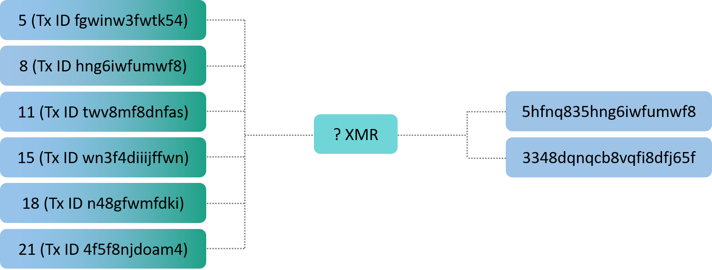
Things Get Complicated Quickly

Slide 29
Network Metadata
Clearnet (No Dandelion)
Clearnet (Dandelion++)
Tor
i2p
ORIGIN
NODE
ORIGIN
NODE
ORIGIN
NODE
ORIGIN
NODE

Slide 30
Summary
OUTSIDER VIEW
5
8
11
5hfnq835hng6iwfumwf8
13
? XMR
3348dqnqcb8vqfi8dfj65f
15
Commitment public key
18
21
Outsiders know the fee, but not which input it came from
Notes:
In summary, for any given transaction, Monero is sent from an ambiguous source, from which an unknown amount is committed and thus an unknown amount is sent, to an unknown receiver or set of receivers. As you can see, all information stored on the blockchain is obfuscated by mandate.

Slide 31
Summary
INSIDER VIEW
5
8
11
5hfnq835hng6iwfumwf8
13
? XMR
3348dqnqcb8vqfi8dfj65f
15
Commitment public key
18
21
Notes:
In summary, for any given transaction, Monero is sent from an ambiguous source, from which an unknown amount is committed and thus an unknown amount is sent, to an unknown receiver or set of receivers. As you can see, all information stored on the blockchain is obfuscated by mandate.

Slide 32
Things Get Complicated Quickly

Slide 33
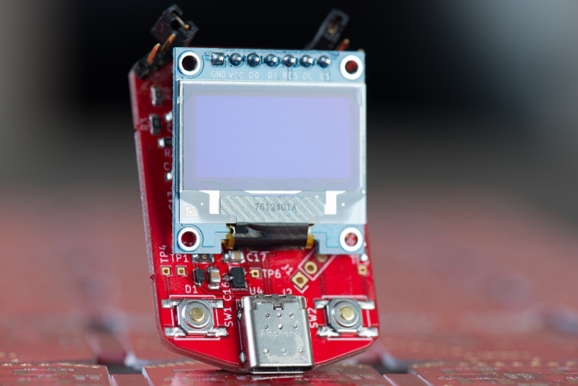
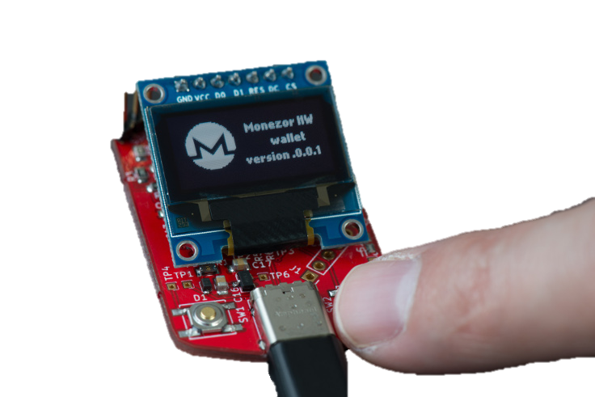
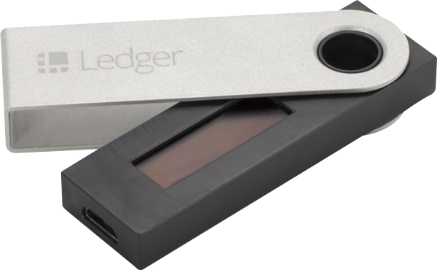
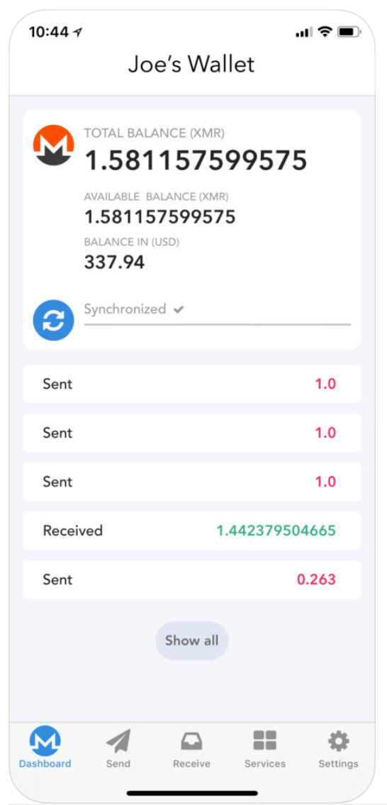
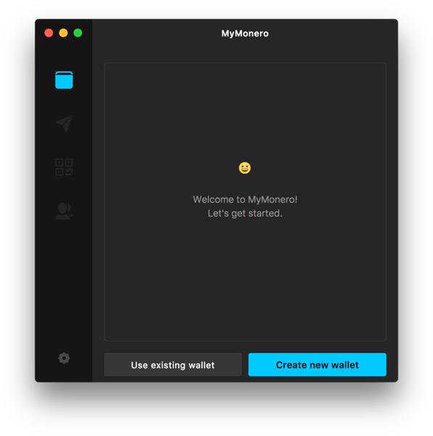
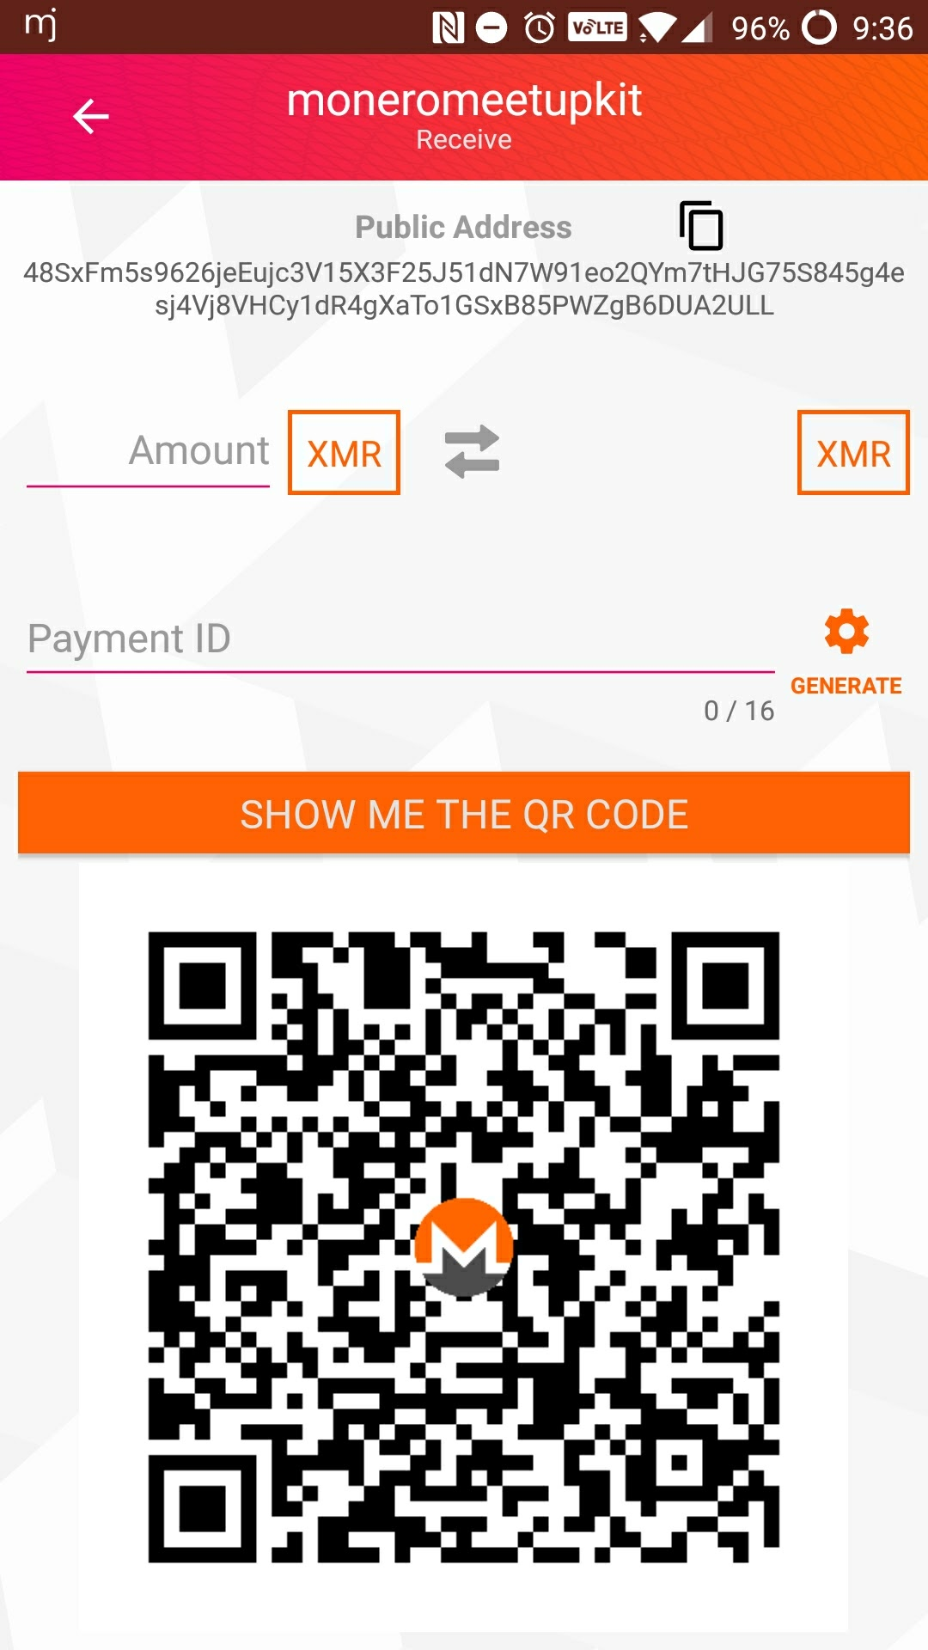
Available Wallets

Slide 34
Efficiency Efficiency Efficiency

Slide 35
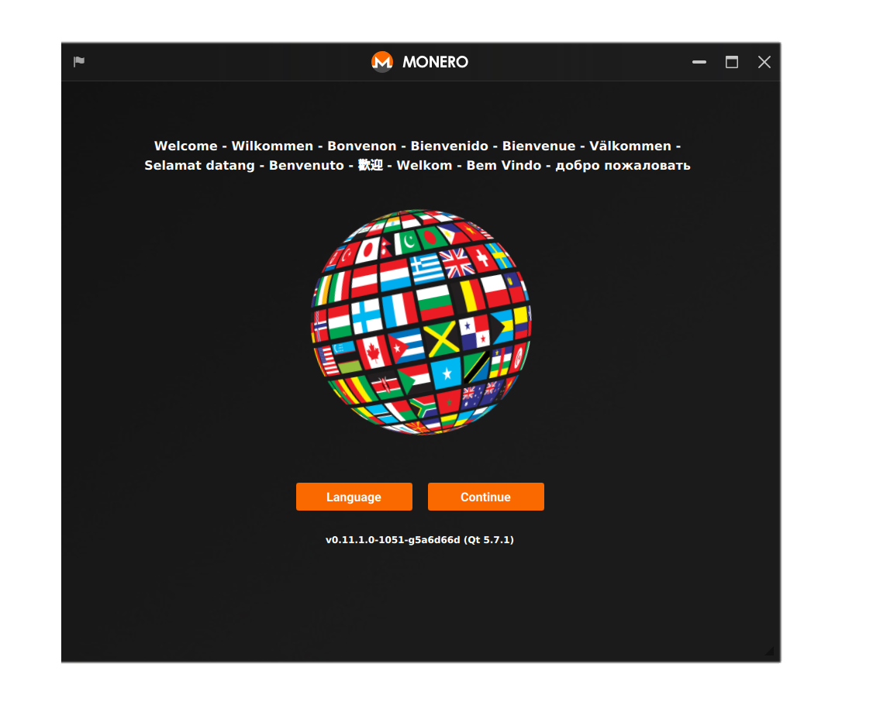
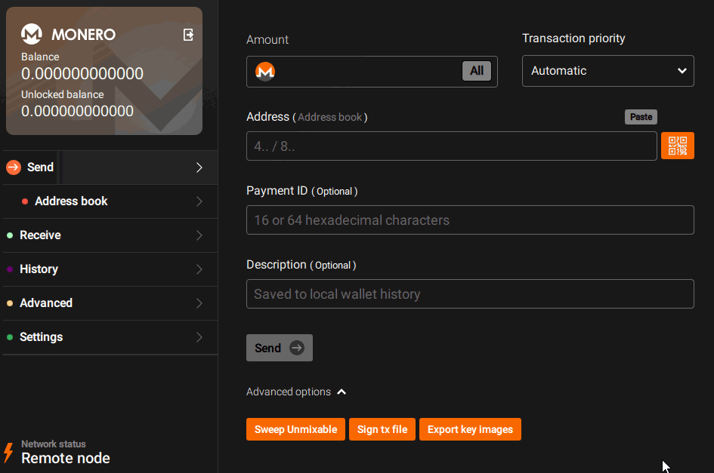
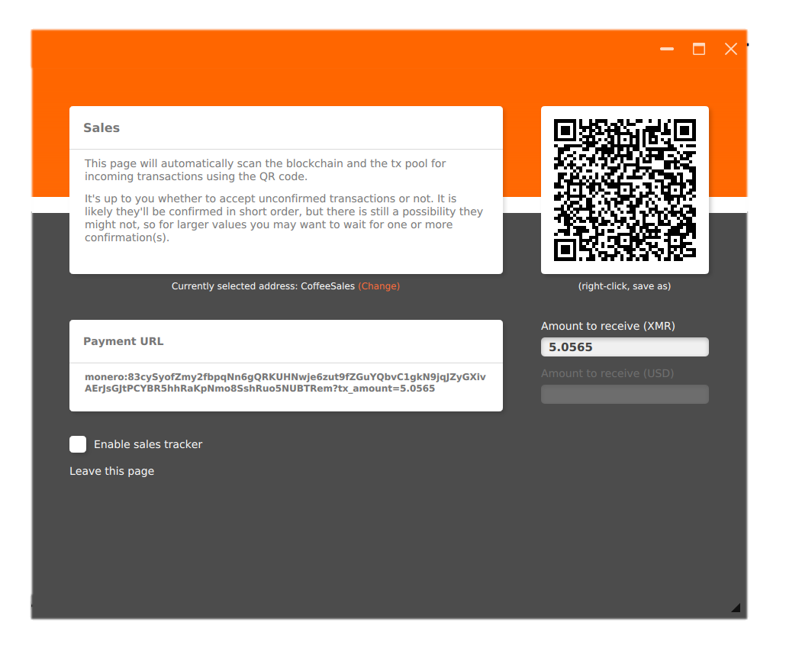

Slide 36
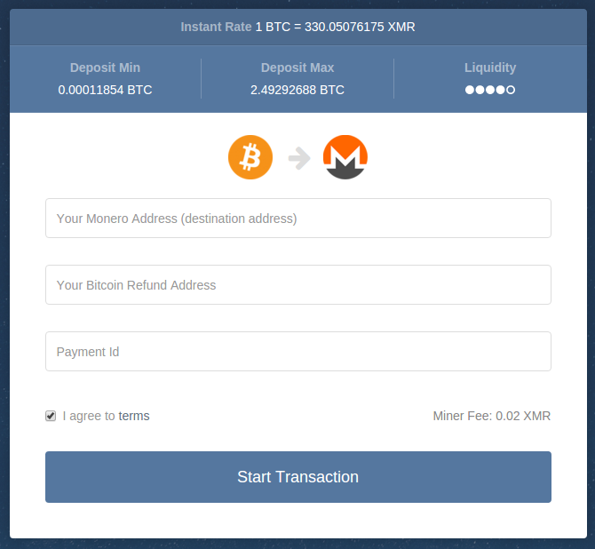
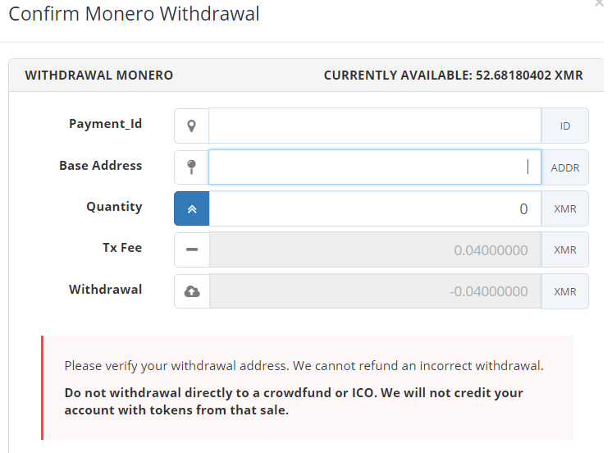
Payment IDs Are Terrible

Slide 37


Side Chains
Older
Newer
BLOCK
LIGHTNING NETWORK
MIMBLE WIMBLE
zkSNARK
TumbleBit

Slide 38
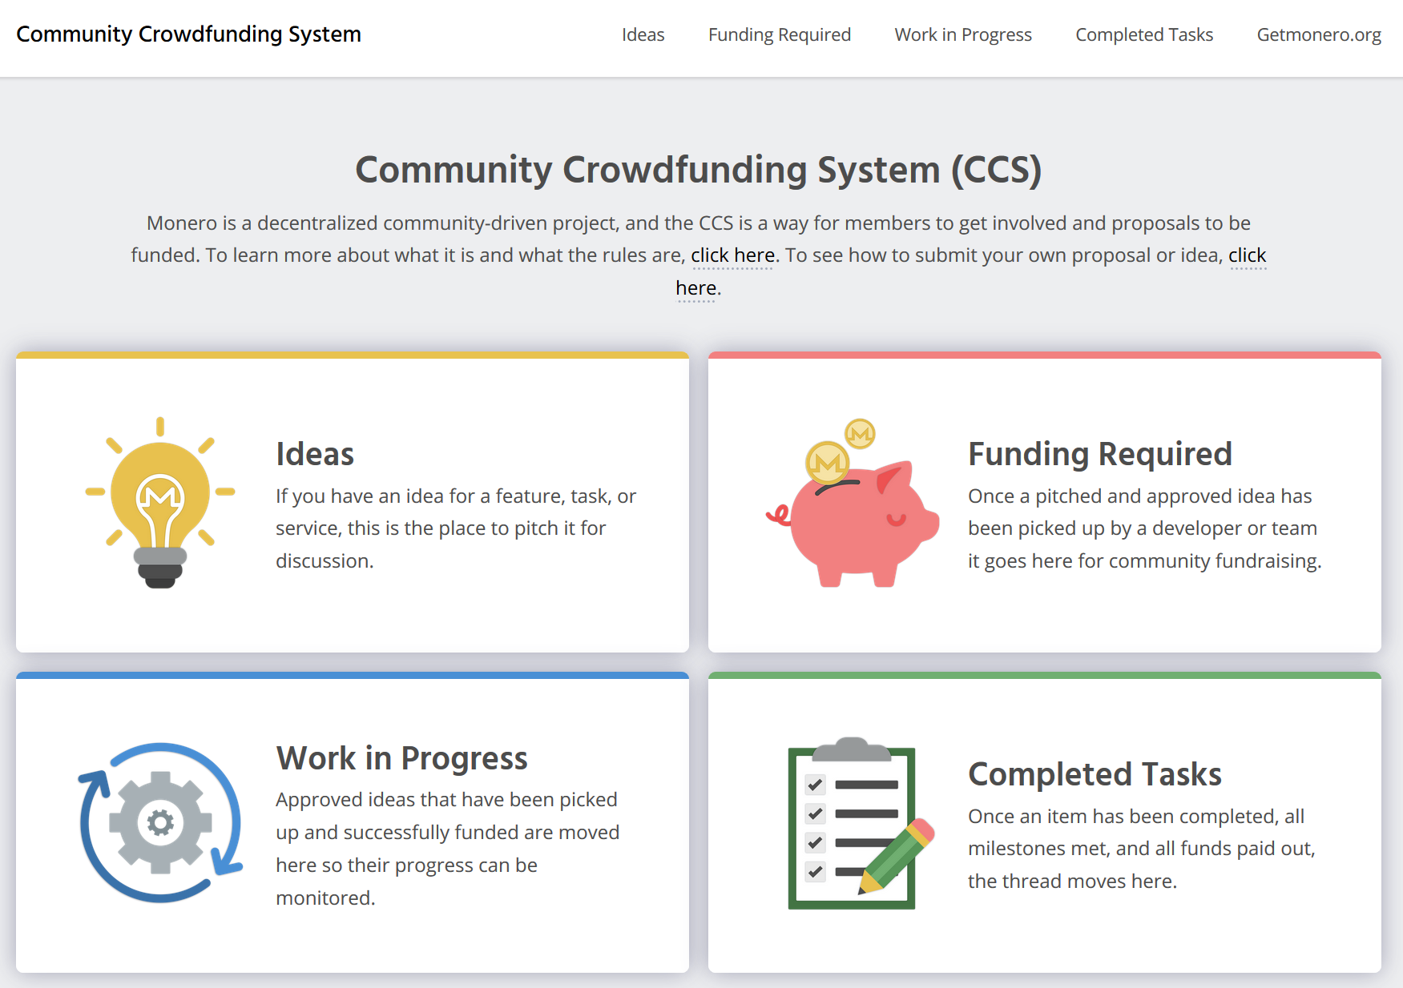

Slide 39
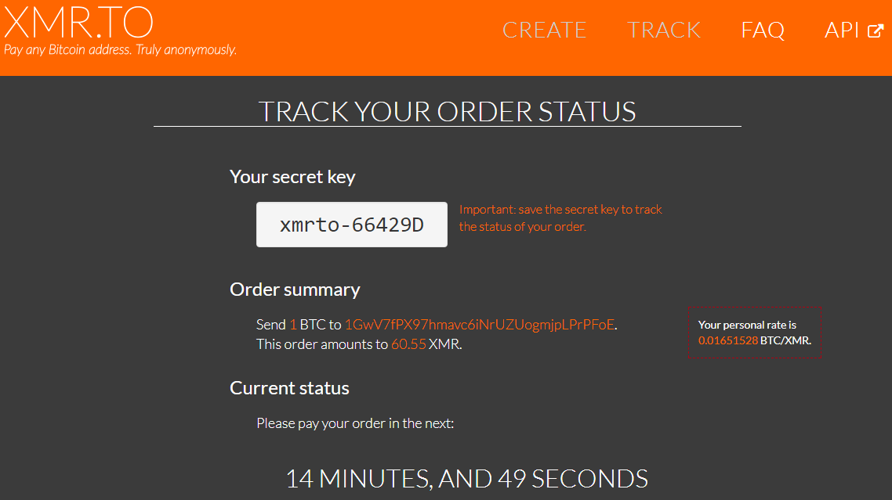
XMR.TO – Pay Bitcoin Addresses with Monero

Slide 40



Why Monero?

Slide 41


Thank You!
getmonero.org
/r/Monero
monero.stackexchange.com
justin@ehrenhofer.org

